Slide 1
Module-1: OOPS CONCEPTS AND JAVA PROGRAMMING:
OOP concepts: Classes and objects, data abstraction, encapsulation, inheritance, benefits of inheritance, polymorphism, procedural and object oriented programming paradigm.
Java programming: History of java, comments data types, variables, constants, scope and life time of variables, operators, operator hierarchy, expressions, type conversion and casting, enumerated types, control flow statements, jump statements simple java stand alone programs, arrays, console input and output, formatting output, constructors methods, parameter passing, static fields and methods, access control, this reference, overloading methods and constructors, recursion, garbage collection, exploring string class

Slide 2
Method Overloading and Constructor Overloading:
Method Overloading and Constructor Overloading in Java are concepts that allow multiple methods or constructors to have the same name but different parameters within the same class. They help improve code readability and flexibility by enabling the same method or constructor to perform different tasks based on the input parameters.
Polymorphism : Compile Time Polymorphism.

Slide 3
Method Overloading:
Definition: Method overloading occurs when two or more methods in the same class have the same name but differ in the number or type of parameters.
Key Points:
Methods must have different parameter lists (either in number, type, or order of parameters).
The return type can be the same or different, but it doesn't influence overloading.
Overloading enhances code readability and reusability.

Slide 4
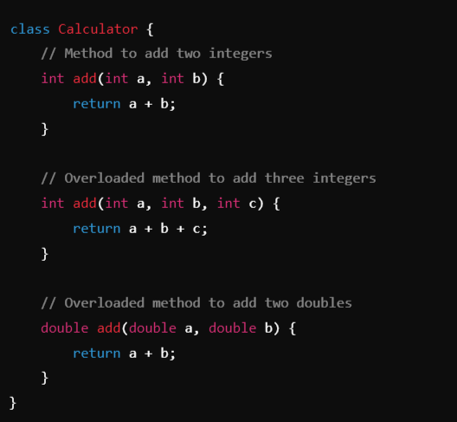
Example:

Slide 5
Constructor Overloading:
Definition: Constructor overloading occurs when a class has multiple constructors with the same name (the class name) but different parameter lists.
Key Points:
Allows creating objects in different ways depending on the arguments passed.
Like method overloading, constructors must differ in the number, type, or order of parameters.
It provides flexibility in initializing objects with different sets of data.

Slide 6
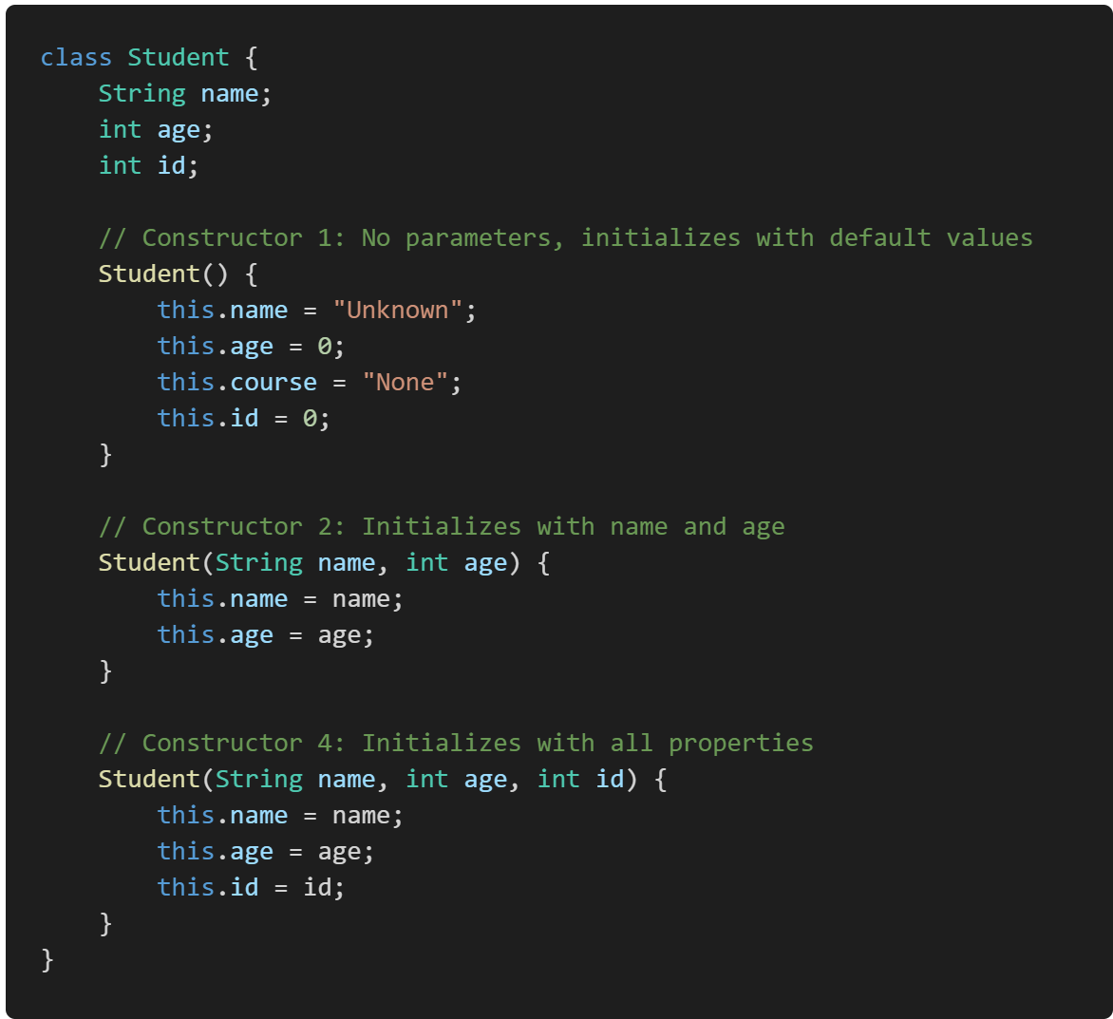
Example:

Slide 7
Run-Time Polymorphism

Slide 8
Method overriding:
Method overriding in Java is a feature that allows a subclass to provide a specific implementation of a method that is already defined in its superclass. This is used to achieve runtime polymorphism and enable the subclass to customize or enhance the behavior of the inherited method.
Key Points of Method Overriding:
Same Method Signature: The overriding method in the subclass must have the same name, return type, and parameters as the method in the superclass.
Annotation: The @Override annotation is often used above the method in the subclass to indicate that it is overriding a method from its superclass (though it is optional).
Access Modifiers: The access level of the overriding method cannot be more restrictive than the overridden method.
Instance Methods Only: Only instance methods (non-static methods) can be overridden. Static methods are not overridden but are hidden instead.

Slide 9
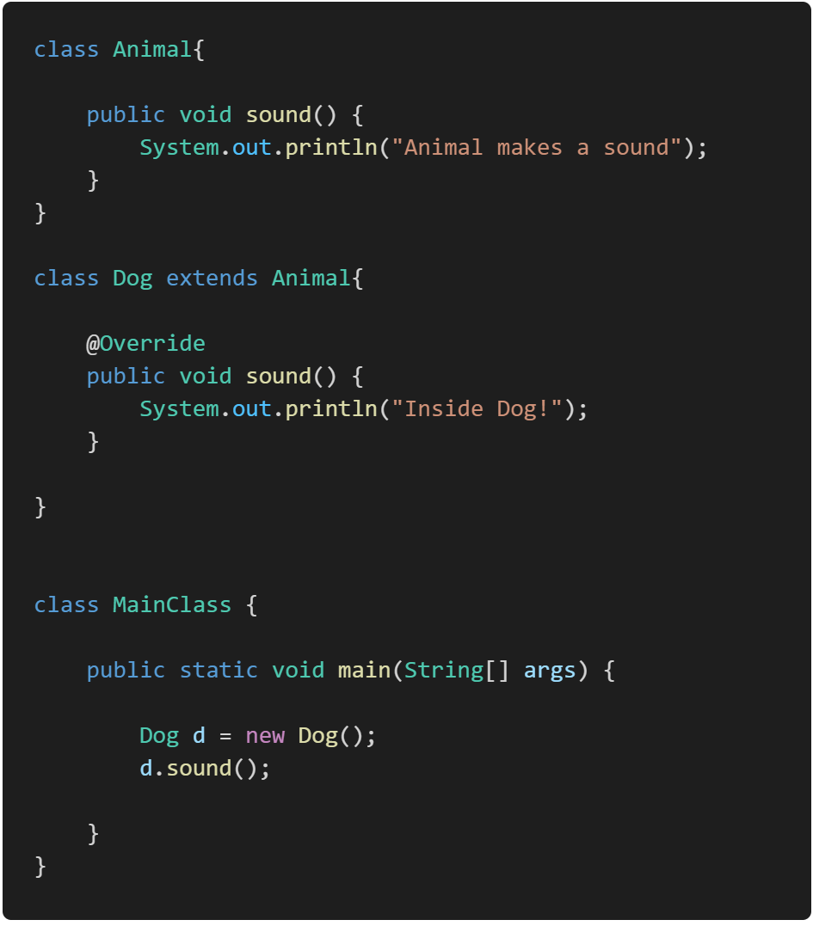
Example:

Slide 10
How to Prevent Method Overriding

Slide 11
Type conversion and Casting:
Type Conversion and Casting in Java are processes that allow you to convert one data type into another. These operations are essential when you need to work with different types of data together.
https://yuvrajscorpio.medium.com/type-casting-in-java-8175fa2875ee

Slide 12
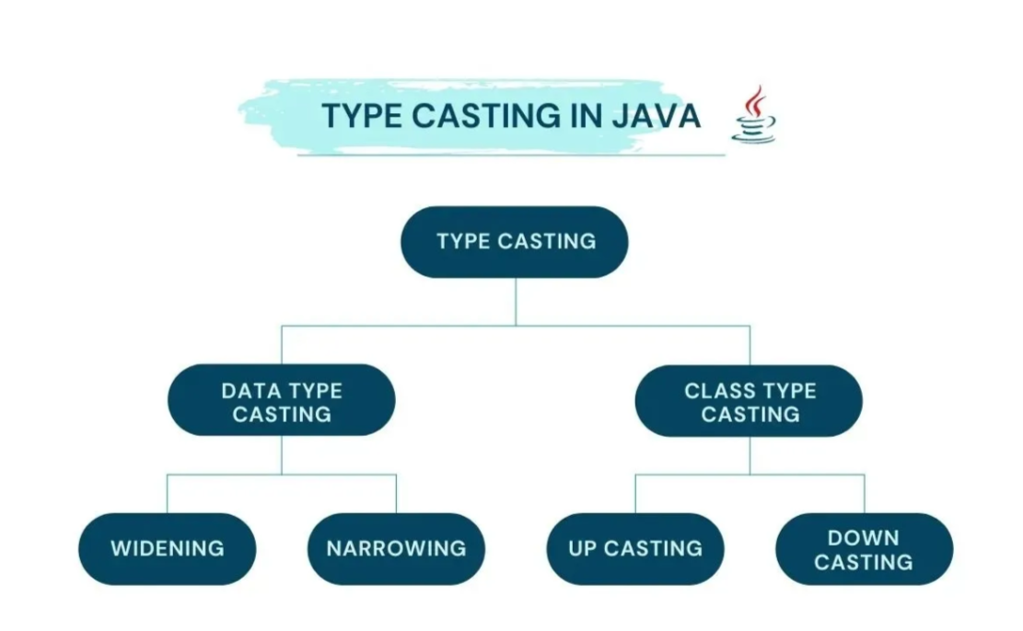

Slide 13
Type Conversion or Casting:
Type conversion, also known as type casting, is the process of converting a value from one data type to another. There are two types of type conversion in Java:
Implicit (Automatic or widening Casting) Type Conversion
Explicit Type Conversion (Mannual Casting or Narrowing Casting)

Slide 14
a. Implicit (Automatic) Type Conversion:
The Java compiler automatically converts a smaller data type into a larger data type without explicit instructions from the programmer. This is also called widening conversion.
Syntax: No explicit syntax is needed as it happens automatically.
This type of casting happens when
Both data types must be compatible with each other.
The target type must be larger than the source type.

Slide 15
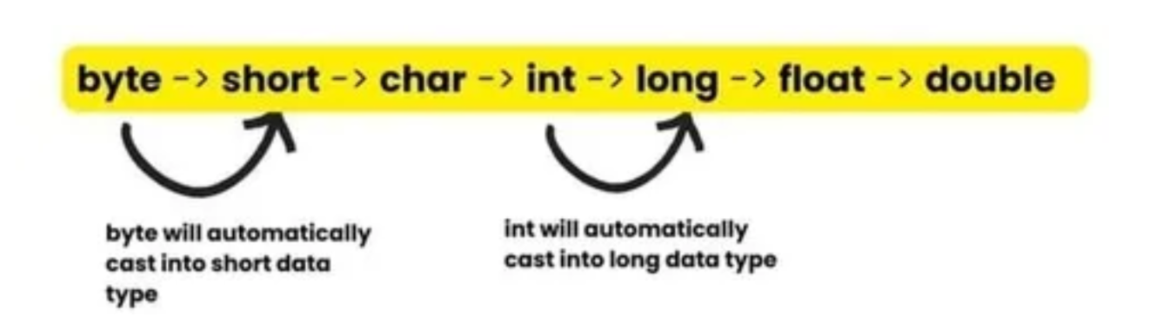
For example, if you assign an integer value to a variable of type double, Java will automatically convert the integer to a double. This is because the range of values that can be stored in a double is larger than the range of values that can be stored in an integer.

Slide 16
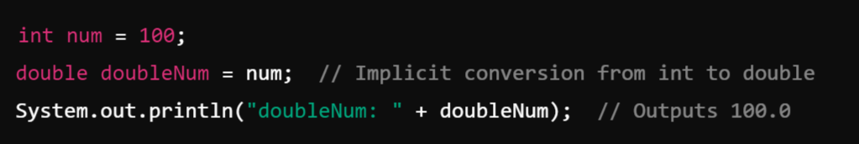
Example:

Slide 17
b. Explicit Type Conversion (Casting):
When you need to convert a larger data type into a smaller data type, or when you need to explicitly convert between types, you must perform explicit casting. This is also called narrowing conversion.
In this process there is high chance that we will lose our data.
Converting a higher data type into a lower one is called narrowing type casting. It is also known as explicit casting or casting down. It is done manually by the programmer. If we do not perform casting, then the compiler reports a compile-time error.
This type of casting happens when
Both data types must be compatible with each other.
The target type must be smaller than the source type.

Slide 18

For example, if you assign a double value to a variable of type int, you will need to manually convert the double to an int using an explicit cast. This is because the range of values that can be stored in an int is smaller than the range of values that can be stored in a double.
To perform an explicit type cast in Java, you place the desired data type in parentheses before the variable that you want to cast.

Slide 19
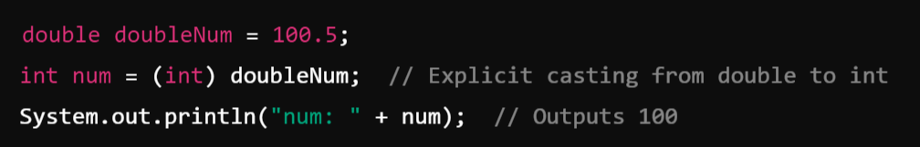
For example:
Note:
It is important to note that explicit type casting can result in data loss if the value being cast is too large to be stored in the new data type. In such cases, the value will be truncated to fit into the new data type, which may result in unexpected behavior.

Slide 20
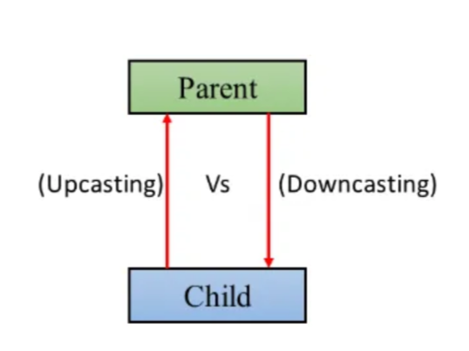
2. Class Type Casting: (Casting between Objects):
Upcasting Vs Downcasting in Java

Slide 21
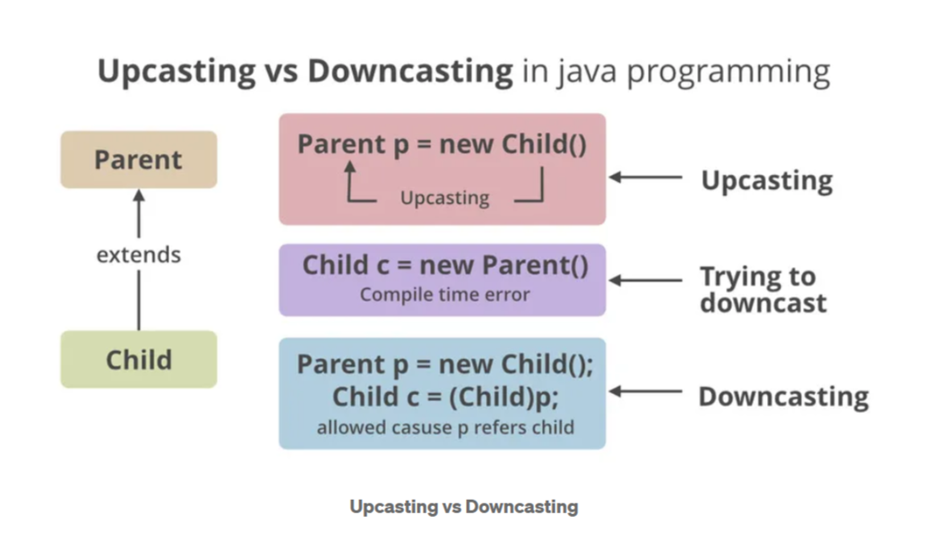

Slide 22
a. Upcasting in Java
Upcasting is the process of converting an object of a subclass to an object of its superclass. This is generally done implicitly by the compiler and is often used to store objects of different subclasses in a collection or array of the superclass type.
For example, if you have a collection of animals, which includes dogs, cats, and birds, you can store all these objects in an ArrayList of the Animal class, which is the superclass of the Dog, Cat, and Bird classes.

Slide 23
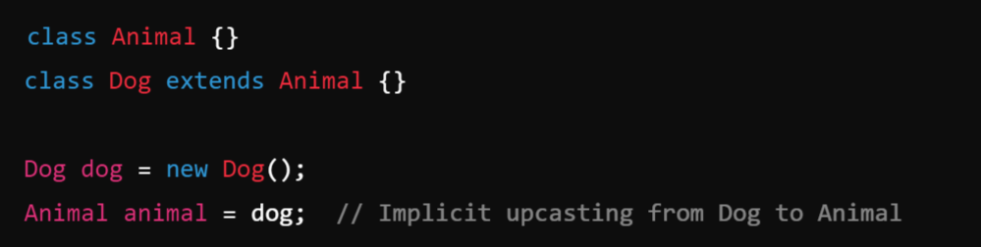
Example:

Slide 24
b. Downcasting in Java
Downcasting is the process of converting an object of a superclass to an object of its subclass. This is an explicit operation that must be performed using the cast operator and can be risky because it may result in a ClassCastException if the object is not actually an instance of the subclass. Downcasting is often used to access methods and properties that are specific to a subclass after an object has been upcasted to its superclass.
For example, if you have an ArrayList of animals and you know that some of the objects in the list are actually dogs, you can downcast those objects to Dog objects in order to call methods that are specific to the Dog class.

Slide 25
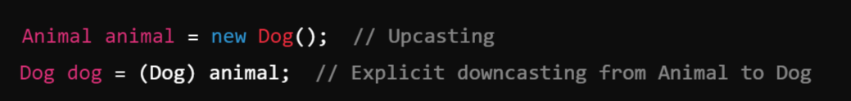
Example:

Slide 26
Garbage Collection:
In Java is an automatic memory management process that helps reclaim memory occupied by objects that are no longer in use, thus preventing memory leaks and optimizing the application’s performance.

Slide 27
Module-2:
MULTIPLE INHERITANCE

Slide 28
Inheritance:
Inheritance is a fundamental concept in object-oriented programming (OOP) that allows a new class (known as a subclass or child class) to inherit properties and behaviors (fields and methods) from an existing class (known as a superclass or parent class). This promotes code reusability and establishes a natural hierarchical relationship between classes.
Key Points:
Super Class (Parent Class):
The class from which properties and methods are inherited.
Example: Animal might be a superclass.
Sub Class (Child Class):
The class that inherits from another class. It can add its own properties and methods, or override the inherited ones.
Example: Dog might be a subclass of Animal.

Slide 29
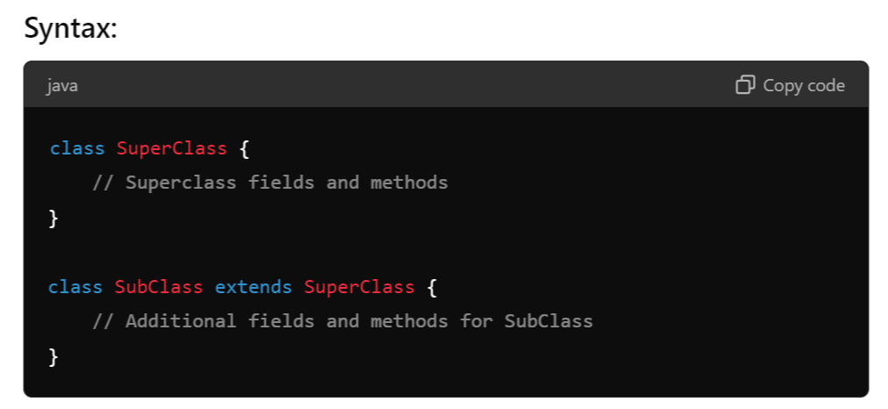

Slide 30
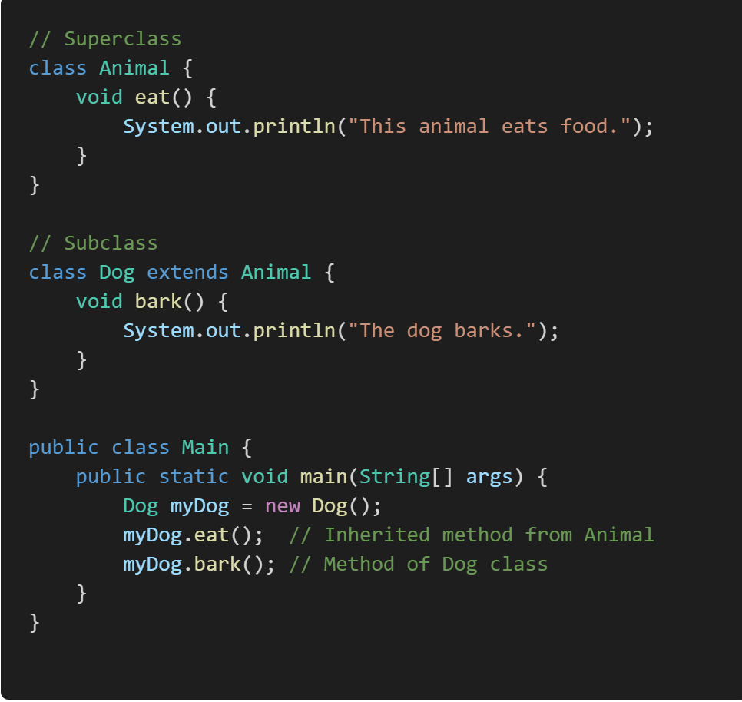
Example:

Slide 31
Inheritance Hierarchies:
An inheritance hierarchy represents the relationships among classes in a multi-level manner, where classes are derived from other classes in a chain.
Single Inheritance: A subclass inherits from only one superclass.
Multi-Level Inheritance: A chain of inheritance where a class is derived from another derived class.
Multiple Inheritance: A class derived from more than one Super class.
Hierarchical Inheritance: Multiple subclasses inherit from a single superclass.
Hybrid Inheritance: A combination of more than one type of inheritance.
Note:
Java doesn't directly support multiple inheritance due to the Diamond Problem, but it can be achieved through interfaces.

Slide 32
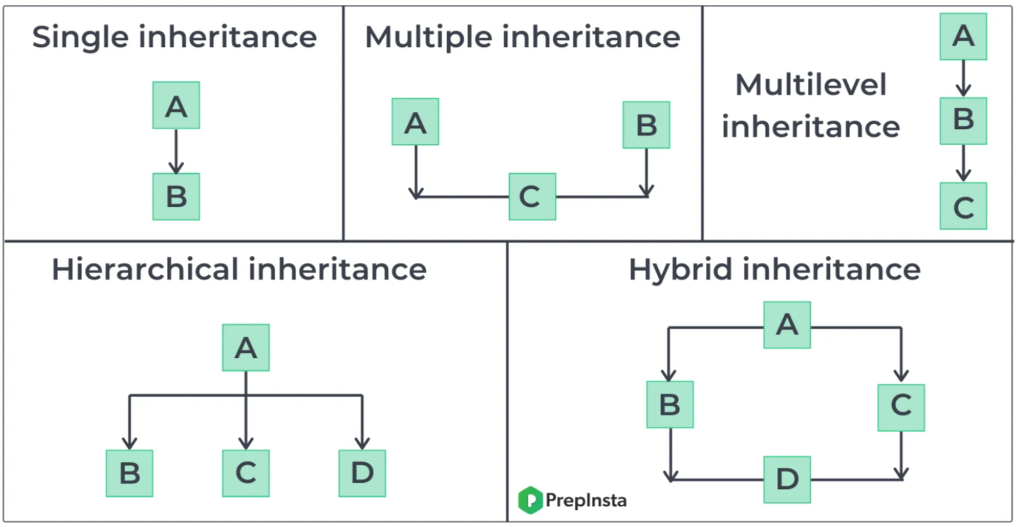

Slide 33
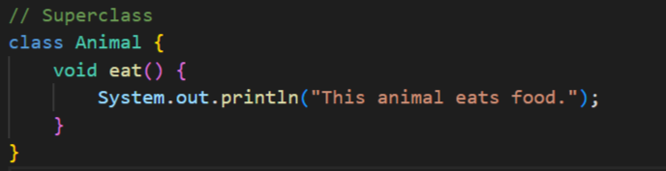
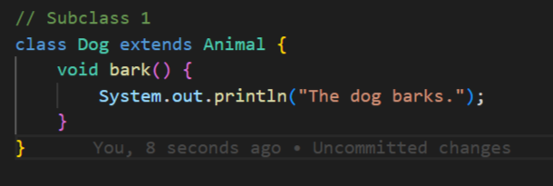
Example:

Slide 34
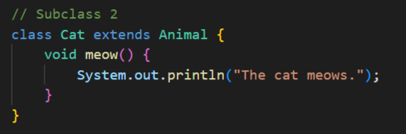
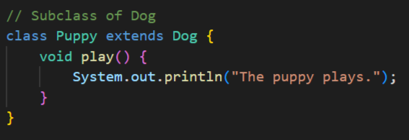

Slide 35
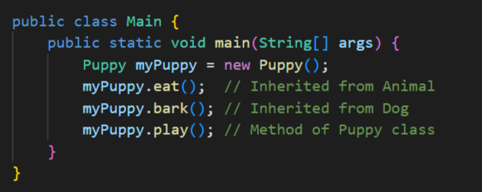

Slide 36
super Keyword:
The super keyword in Java is used in three main contexts:
Accessing the Parent Class Constructor
Accessing Parent Class Methods
Accessing Parent Class Fields
Overall, super is mainly used to differentiate between members of a parent class and the current class, ensuring the correct fields, methods, or constructors are accessed.
Note:
super: The super keyword is used to refer to the immediate parent class. However, super can only be used within a method or a constructor. You cannot use super directly in the class body

Slide 37
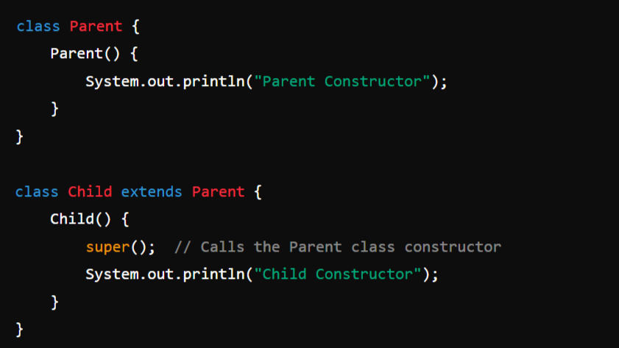
1. Accessing the Parent Class Constructor:
It is used to call a constructor of the parent class from a subclass. This is typically done to initialize the parent class's fields when an instance of the subclass is created.
Example:

Slide 38
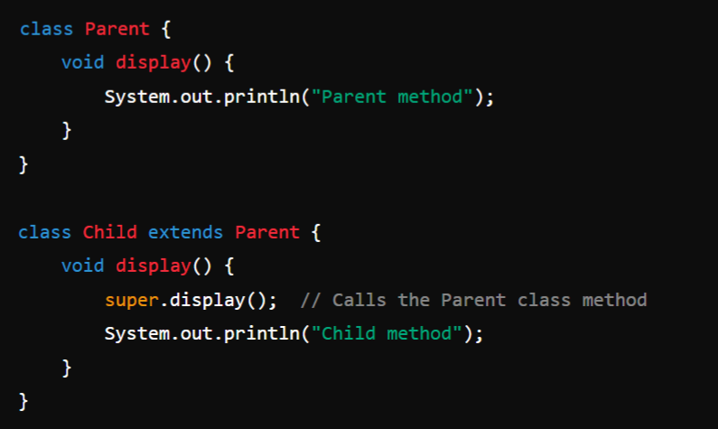
2. Accessing Parent Class Methods:
super can be used to call a method from the parent class that has been overridden in the child class.
Example:

Slide 39
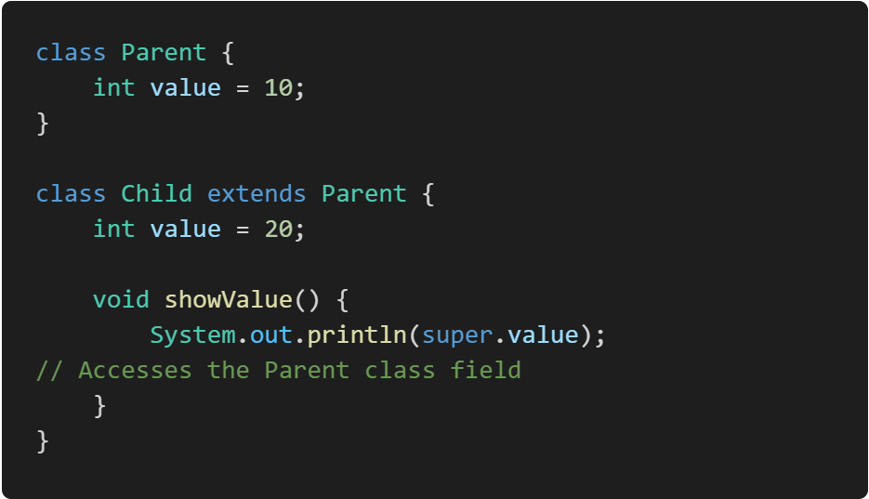
3. Accessing Parent Class Fields:
If a field in a subclass hides a field in its superclass, super can be used to refer to the superclass's field.
Example:

Slide 40
Preventing inheritance:
final Keyword:
In Java, the final keyword can be applied to classes and methods to restrict their usage or modification.

Slide 41
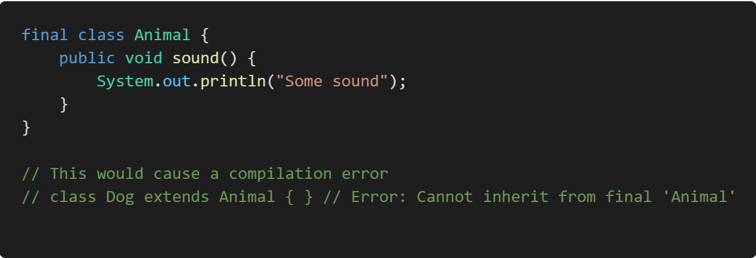
final Classes:
A final class is a class that cannot be subclassed or extended. This is useful when you want to prevent other classes from inheriting your class, ensuring that its implementation remains unchanged.
Example:

Slide 42
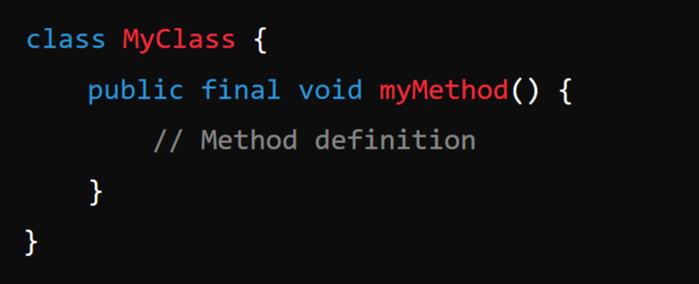
final Methods:
A final method is a method that cannot be overridden by subclasses. This is useful when you want to ensure that a method's implementation remains unchanged in any subclass.
Syntax:

Slide 43
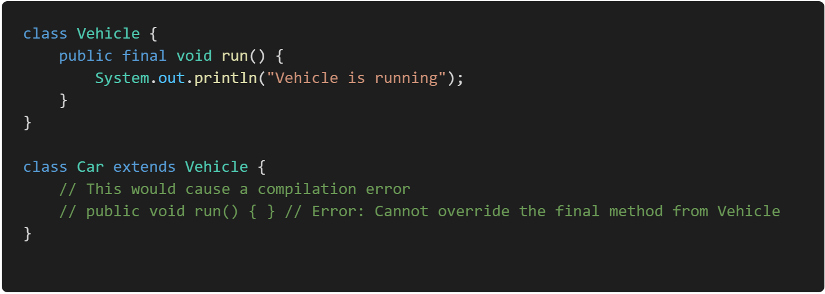
Example:

Slide 44
Object Class:
In Java, an Object is the root class of the Java class hierarchy. Every class in Java is implicitly a subclass of the Object class, either directly or indirectly. This means that all Java classes inherit the methods defined in the Object class.
When I say "every class in Java is implicitly a subclass of the Object class," I mean that no matter what class you create in Java, it automatically inherits from the Object class, even if you don’t explicitly specify a parent class. This inheritance happens by default.

Slide 45
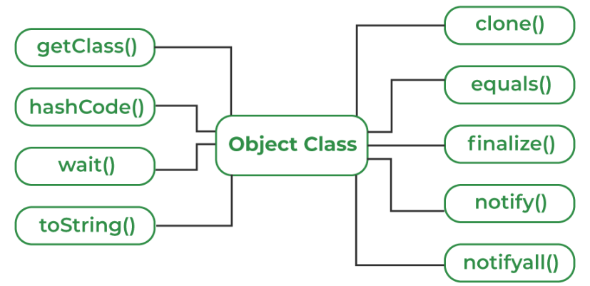
Methods of Object Class:
Object class is present in java.lang package. Every class in Java is directly or indirectly derived from the Object class. If a class does not extend any other class then it is a direct child class of Object and if extends another class then it is indirectly derived. Therefore the Object class methods are available to all Java classes. Hence Object class acts as a root of the inheritance hierarchy in any Java Program.
Methods:

Slide 46
toString(): Returns a string representation of the object.
Syntax:
public String toString()

Slide 47
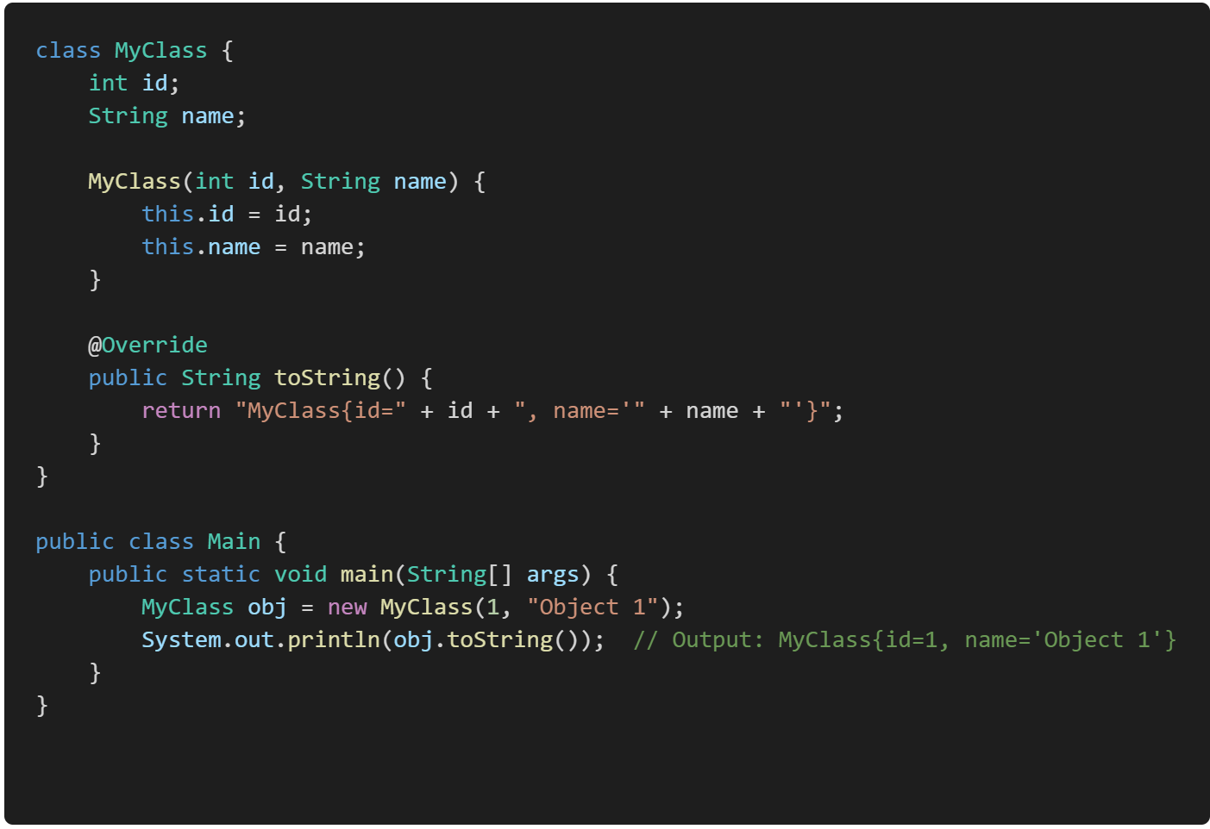
Example:

Slide 48
2. equals(Object obj): Compares this object with the specified object for equality.
Syntax:
public boolean equals(Object obj)

Slide 49
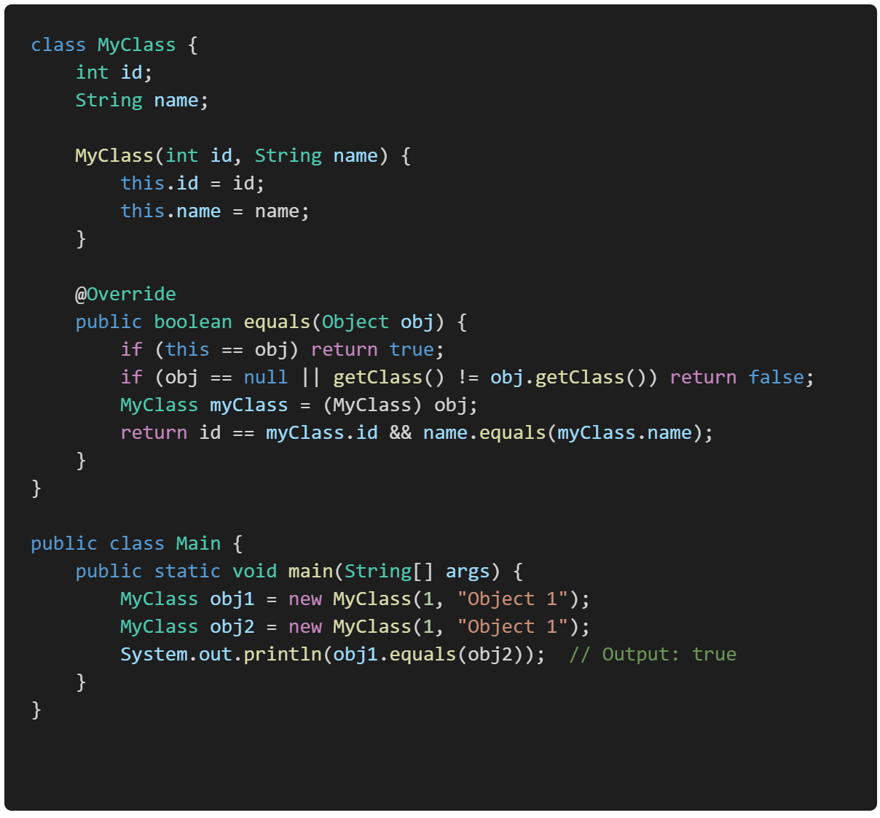
Example:
The equals method in the above example is a custom implementation of the equals() method in Java. This method is used to compare two objects for equality, and it’s typically overridden in classes where you want to define what it means for two objects to be considered "equal."

Slide 50
3. hashCode(): Returns a hash code value for the object, which is used in hashing-based collections like HashMap.
A hash code value is an integer that is generated by the hashCode() method in Java. This value is used to uniquely represent an object in hashing data structures like HashMap, HashSet, and Hashtable.
Syntax:
public int hashCode()

Slide 51
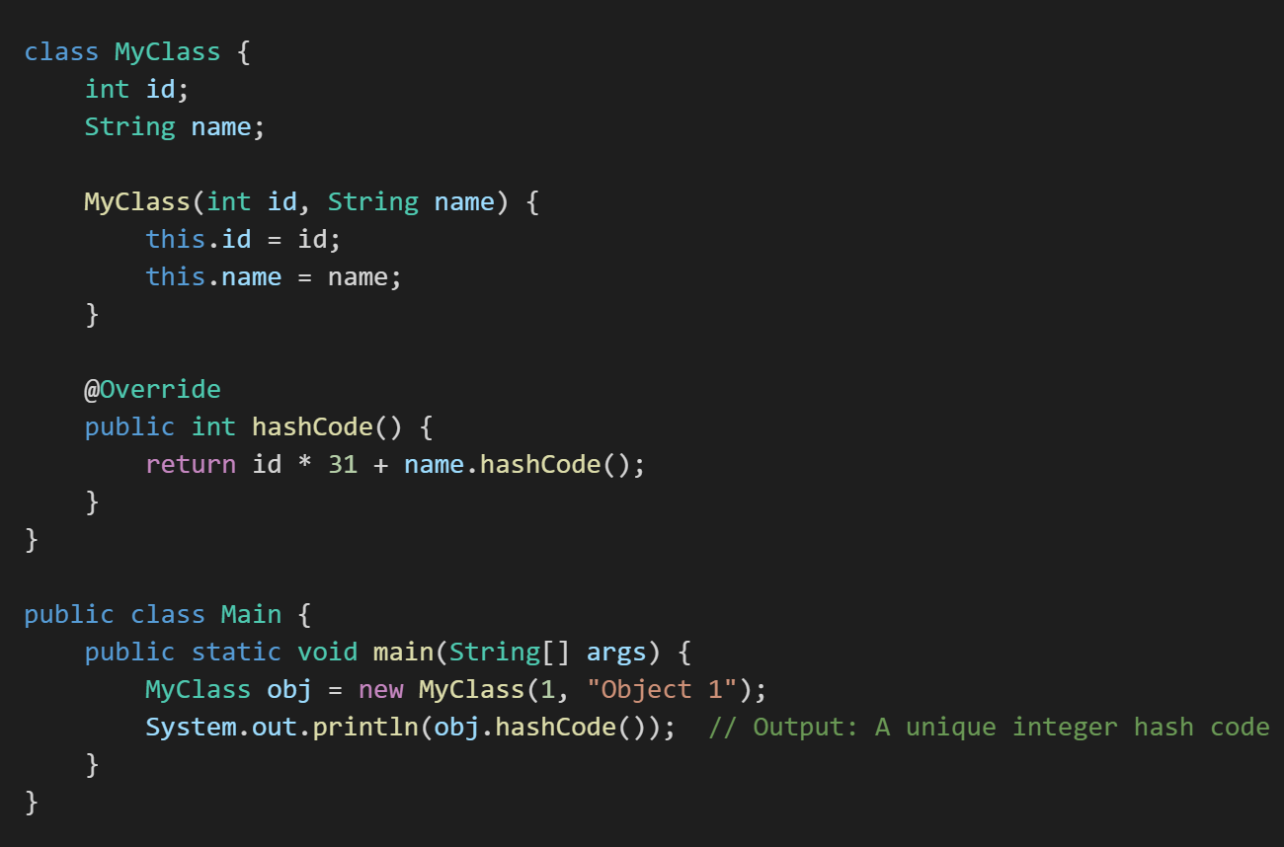
Example:

Slide 52
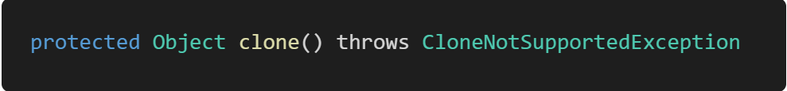
4. clone():
Purpose: Creates and returns a copy (clone) of the object. The class must implement the Cloneable interface.
Syntax:

Slide 53
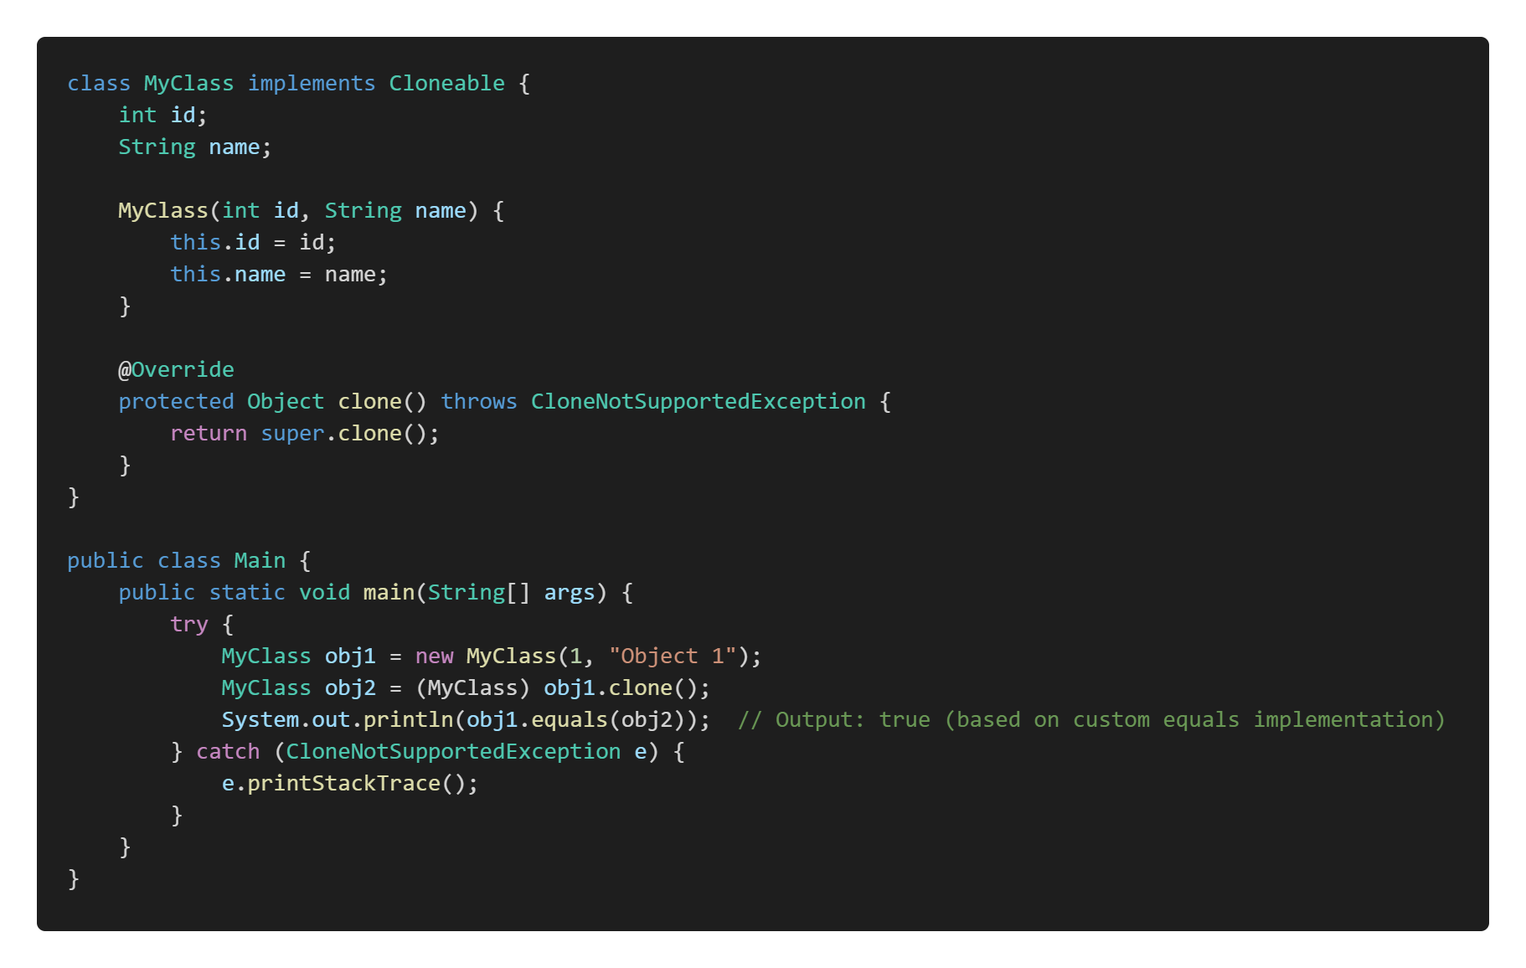
Example:

Slide 54
5. finalize():
The finalize() method in Java is a special method that the garbage collector calls before an object is removed from memory. It allows the object to perform any cleanup operations, such as releasing resources or closing files. However, it is rarely used because relying on finalize() can lead to unpredictable behavior. So this will be handled by the Garbage Collector Automatically.
Syntax:
protected void finalize() throws Throwable

Slide 55
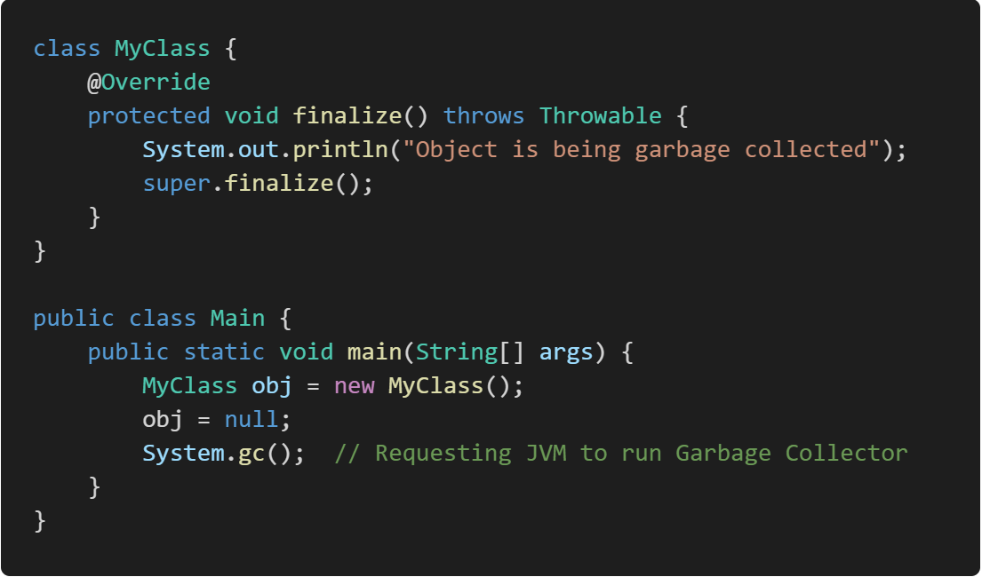
Example:

Slide 56
6. getClass(): Returns the runtime class of the object.
In Java, the getClass() method is used to obtain the runtime class of an object. The runtime class of an object refers to the actual class type of the object as it exists during the execution of the program, not necessarily the type as known at compile time.
For example, if you have a variable declared as Object but it actually references an instance of String, calling getClass() on that variable will return the Class object representing String. This can be useful for reflection, debugging, or when you need to perform operations based on the exact type of the object at runtime.

Slide 57
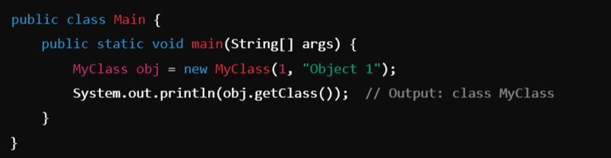
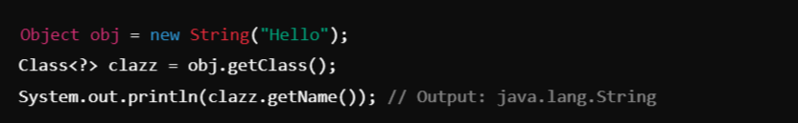
Example-1:
Example-2:

Slide 58
7. notify() :
In Java, the notify() method is used in multi-threaded programming to wake up a single thread that is waiting on the object's monitor (lock). Here's a brief explanation:
Context: When multiple threads are involved in a task, some threads might need to wait for certain conditions to be met before they can proceed. This is typically done using the wait() method, which causes a thread to wait until another thread notifies it that it can continue.
Usage of notify(): The notify() method is called on an object to wake up one of the threads that is currently waiting on that object's monitor. Only one thread is awakened, and it is chosen by the JVM (Java Virtual Machine) in a somewhat random fashion if multiple threads are waiting.
Syntax: public final void notify()

Slide 59
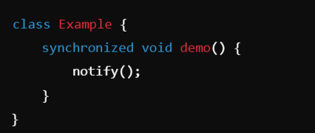
Example:
Synchronized Method (demo()):
The demo() method is marked as synchronized. This means that when a thread calls demo() on an instance of Example, it acquires the lock (monitor) on that instance before executing the method.
Only one thread can execute the demo() method at a time on the same object. If another thread tries to call demo() or any other synchronized method on the same object, it will block (wait) until the lock is released.
So here only one instance of Example will hold the control until and unless it calls the demo() method and inside it will execute the notify() method to release the lock, so that other objects can access it. notify() is used to wake up one thread that is waiting on the object’s lock (monitor).

Slide 60
8. notifyAll(): Wakes up all threads that are waiting on this object's monitor (Internal Lock). This lock, or monitor, is a mechanism that ensures that only one thread can access a synchronized block or method on that object at a time.
Syntax: public final void notifyAll()
When a thread calls notifyAll() on an object, all threads that are currently waiting on that object's monitor (using the wait() method) are awakened.
These threads do not immediately resume execution; they must re-acquire the lock on the object before they can proceed. Since only one thread can hold the lock at a time, the awakened threads will compete to acquire it.
Like notify(), notifyAll() must be called from a synchronized context, meaning the thread must have the monitor (lock) of the object.

Slide 61
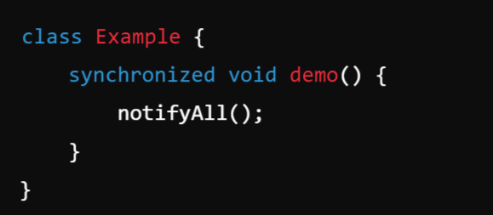
Example:

Slide 62
9. wait() and wait(long timeout):
Causes the current thread to wait until another thread invokes notify() or notifyAll() on this object. So the wait() method will make the current thread pause its execution until another thread signals it to continue.
Syntax:
public final void wait() throws InterruptedException
public final void wait(long timeout) throws InterruptedException

Slide 63
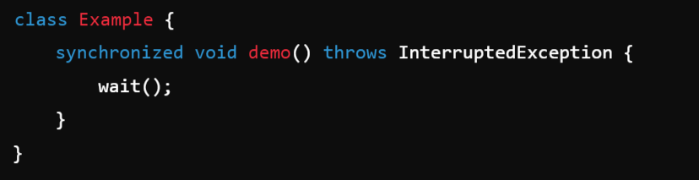
Example:
The wait(1000) method is called inside demo(), which tells the current thread to wait for up to 1,000 milliseconds (1 second).
This method causes the current thread to release the lock on the object (in this case, the instance of Example), and the thread enters a waiting state.

Slide 64
Polymorphism
Compile-Time
Static Binding
Early Binding
Compile-Time Binding
Run-Time
Dynamic Binding
Late Binding
Run-Time Binding
Method Overloading
Method Overriding
Constructor Overloading
Operator Overloading

Slide 65
Static Binding (Early Binding): Static binding, also known as early binding or compile-time binding, refers to the process where the method to be executed is determined at compile time rather than at runtime. This is in contrast to dynamic binding, which occurs at runtime.
Dynamic Binding (Late Binding):
Dynamic binding in Java refers to the process by which a method call is resolved to the appropriate method implementation at runtime, rather than at compile time. This concept is crucial for achieving polymorphism in object-oriented programming.

Slide 66
Data Abstraction
Abstract Classes and Methods

Slide 67
Abstract Method:
An abstract method is a method declared without a body. It must be overridden in the subclass. The method signature includes the abstract keyword, and there is no method body.
Key Rules for Abstract Methods:
Must be declared in an abstract class.
Cannot have a method body.
Subclasses that extend the abstract class must override the abstract method.

Slide 68
Abstract Class:
An Abstract Class in object-oriented programming is a class that cannot be instantiated directly. It serves as a blueprint for other classes. Abstract classes are used when you want to define some common behavior (methods) that other classes should inherit and implement, but the abstract class itself should not be instantiated. In other words, an abstract class can have abstract methods (without implementation) and/or concrete methods (with implementation).

Slide 69
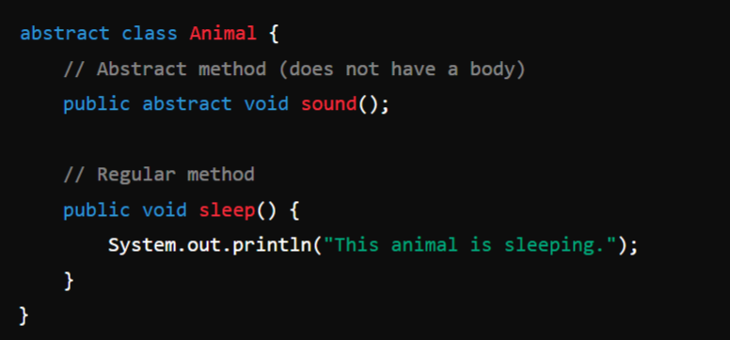
Example:

Slide 70
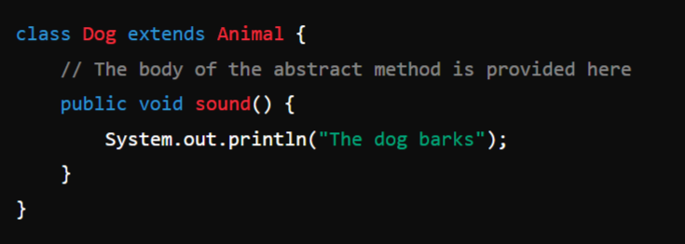
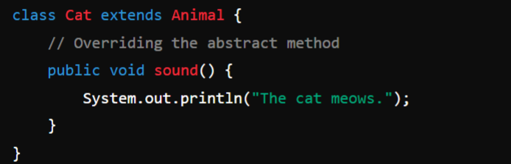
Usage:

Slide 71
Rules for Abstract Classes:
Cannot be instantiated
Can have abstract methods
Can have concrete methods
Subclasses must override abstract methods
Subclasses can be abstract

Slide 72
Module-2: MULTIPLE INHERITANCE
Inheritance: Inheritance hierarchies, super and subclasses, member access rules, super keyword,
Preventing inheritance: final classes and methods, the object class and its methods.
Polymorphism: dynamic binding, method overriding ,abstract classes and methods.
Module-3: INTERFACES AND PACKAGES
Interface: Interfaces VS Abstract classes, defining an interface, implement interfaces, accessing implementations through interface references, extending interface.
Packages: Defining creating and accessing a package, understanding CLASSPATH, importing packages

Slide 73
Super Keyword
Object Class

